Slide 1

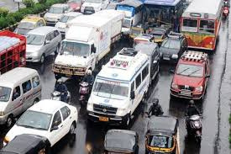

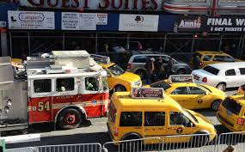
SMART ROUTE
MANEUVERING
SYSTEM
A LIFE SAVING INITIATIVE
By TRAILBLAZERS

Slide 2

About Trailblazers
We are Trailblazers, a dedicated team participating in the Smart India Hackathon. Our mission is to enhance road safety and streamline emergency response through our innovative solution, SMART ROUTE MANEUVERING SYSTEM.
OUR TEAM
Saksham Kumar Kannojia
Team Leader
Surbhi Arora
Frontend Developer
Tarunesh Singh Mehra
Research and Development
Ankit Upreti
Frontend Developer
Pranjal Sharma
Research
and
Analysis
Vanshika Mohiley
Backend Developer

Slide 3

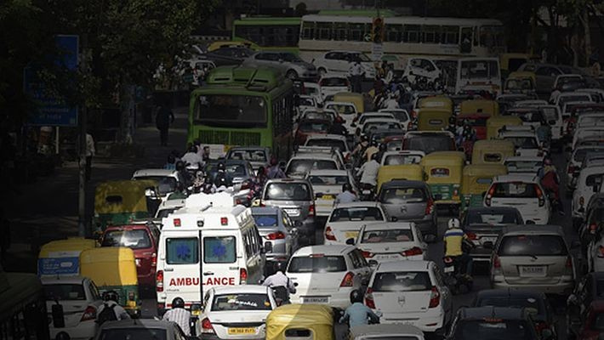
Addressing the issue!...
In urban areas, traffic congestion can severely delay emergency services, costing valuable time and lives.
Emergency vehicles often get stuck in traffic jams due to lack of emergency lanes, even with sirens and lights, leading to increased response times..
Lives are tragically lost when emergency services are delayed in traffic jams, as every second counts during critical situations.
8

Slide 4
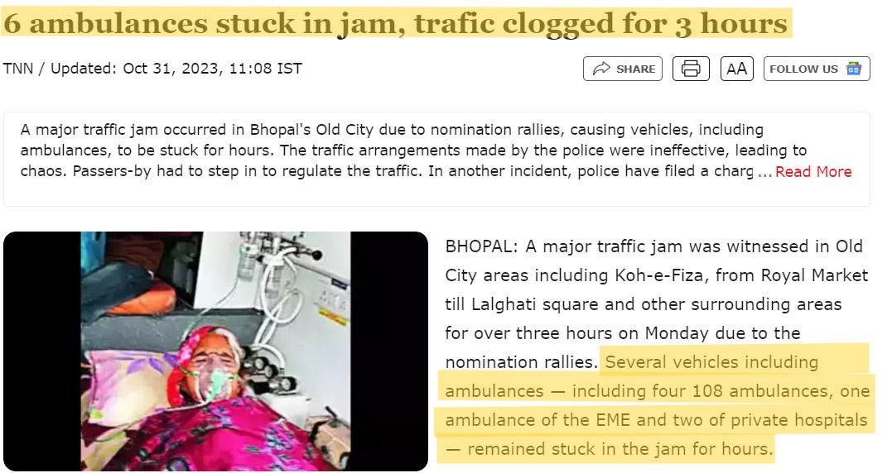
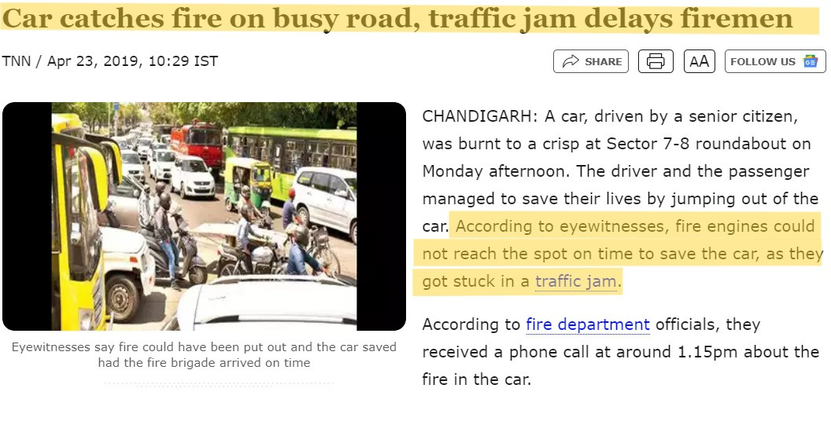
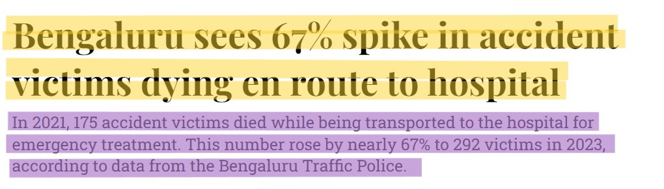
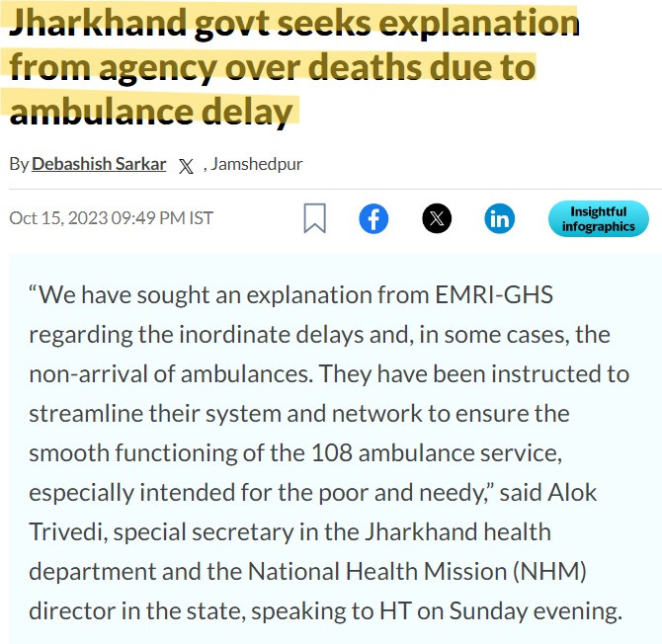
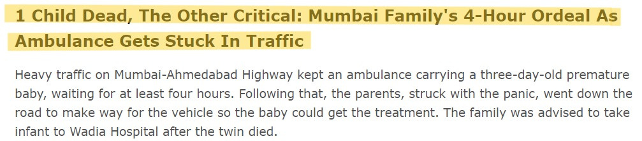
The Issue

Slide 5
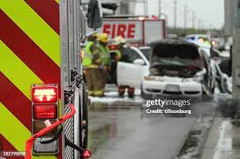
What we are offering...
Our system provides:
Real-time GPS tracking of emergency vehicles
Dynamic traffic signal control to prioritize emergency vehicles
Alerts to regular drivers via mobile apps or digital boards
A reduction in response time, potentially saving lives
8

Slide 6
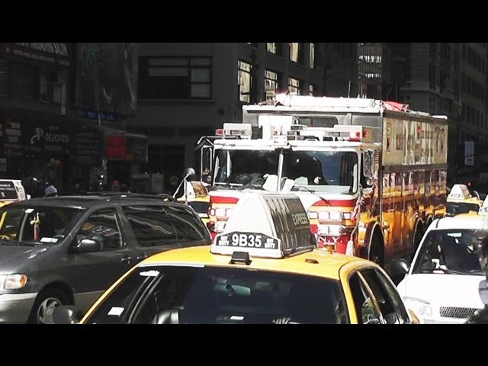
Technical Implementation
FRONTEND:
Driver notification system with alerts.
Cloud services for scalability and fast data processing.
login and registration preface for emergency departments to feed the data regarding the respective vehicles.
BACKEND:
Real-time GPS data processing.
Traffic Signal Control: Automatic signal prioritization.
8

Slide 7

Conclusion
Implementing an Emergency Service Route Rationalization System is vital to improving response times and saving lives during critical emergencies. By optimizing traffic flow and prioritizing emergency vehicles, such a system can minimize delays caused by congestion, ensuring that help arrives when it's needed most. This technological advancement not only enhances public safety but also reduces the risk of preventable deaths and damage. Ultimately, an efficient and well-planned system can transform urban mobility, making cities safer and more resilient in times of crisis.

Slide 8
RESEARCH AND REFERENCES
Details / Links of the reference and research work:-
•https://www.deccanherald.com/india/karnataka/bengaluru/city-sees-spike-in-accident-victims-dying-en-route-to-hospital-2998128
•https://www.hindustantimes.com/cities/ranchi-news/jharkhand-govt-seeks-explanation-from-agency-over-deaths-due-to-ambulance-delay-101697386785120.html
•https://timesofindia.indiatimes.com/city/bhopal/6-ambulances-stuck-in-jam-trafic-clogged-for-3-hours/articleshow/104839760.cms
•https://timesofindia.indiatimes.com/city/chandigarh/car-catches-fire-on-busy-road-traffic-jam-delays-firemen/articleshow/69002039.cms
•https://www.timesnownews.com/mumbai/1-child-dead-the-other-critical-mumbai-familys-4-hour-ordeal-as-ambulance-gets-stuck-in-traffic-article-108130697

Slide 9

Thank You
Presented by Trailblazers

